Slide 1


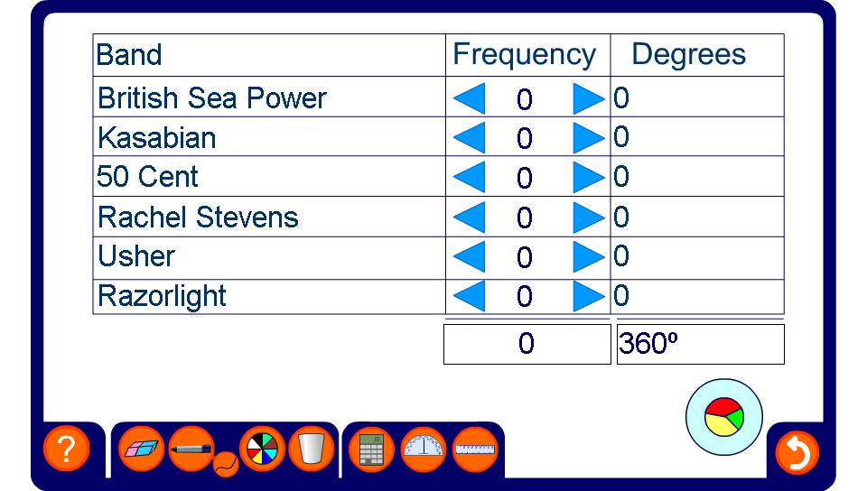


Converting data into angles
Notes:
Decide on the most popular six bands in the class. Then ask pupils for their favourite. Input the data in the first two columns, and ask pupils to work out the angles.
What conclusions can you draw from your pie chart?
Can you convert your angles into percentages?
What is the mode?
The heading of the first column can be changed so that you can graph other things too.

